Slide 1
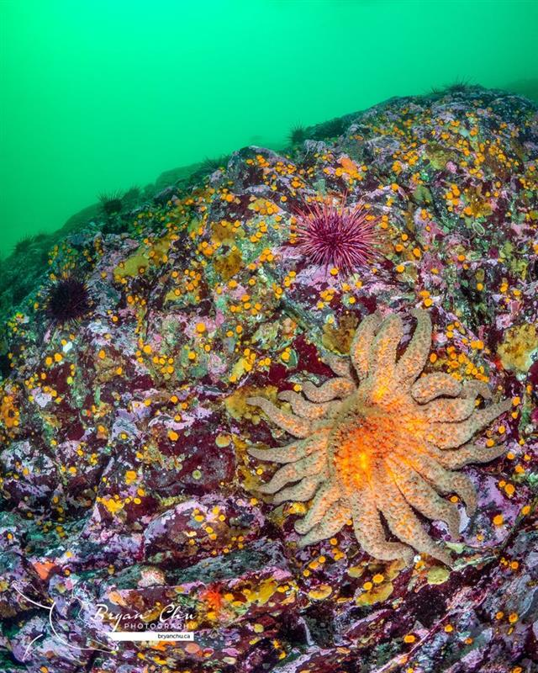
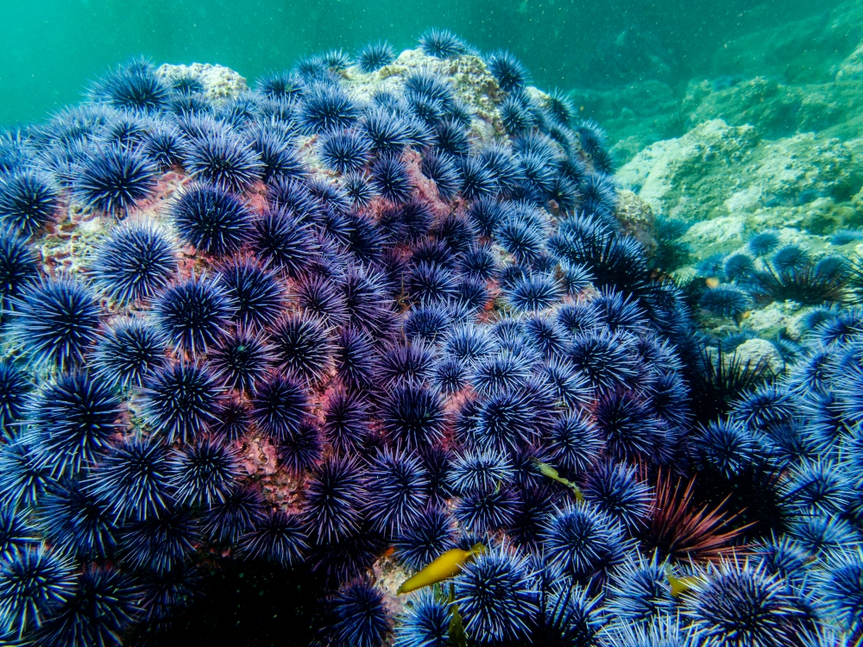
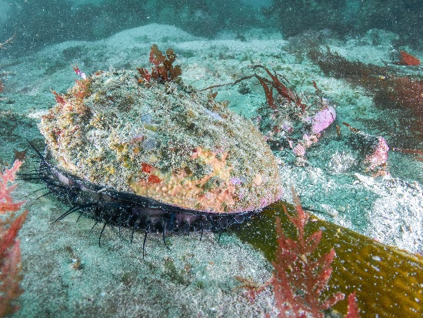
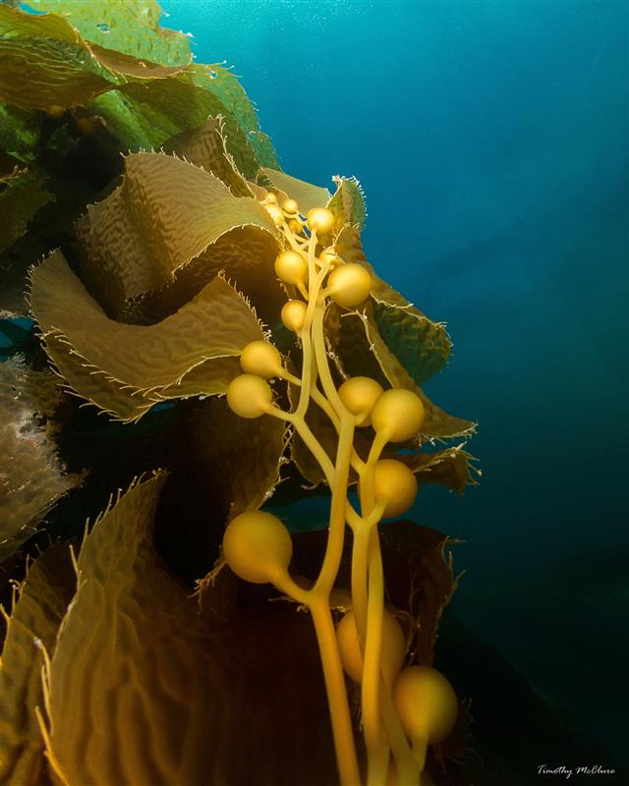
San Miguel Island Recent Community Changes
Kelp Forest Monitoring Program
Notes:
I joined KFM in 2017. Since then, the south side of San Miguel Island has seen significant changes. Todays talk is going to emphasize these changes and discuss the implications. This talk will mirror last weeks talk in a lot of ways, and the only new species we really added are red abalone.

Slide 2
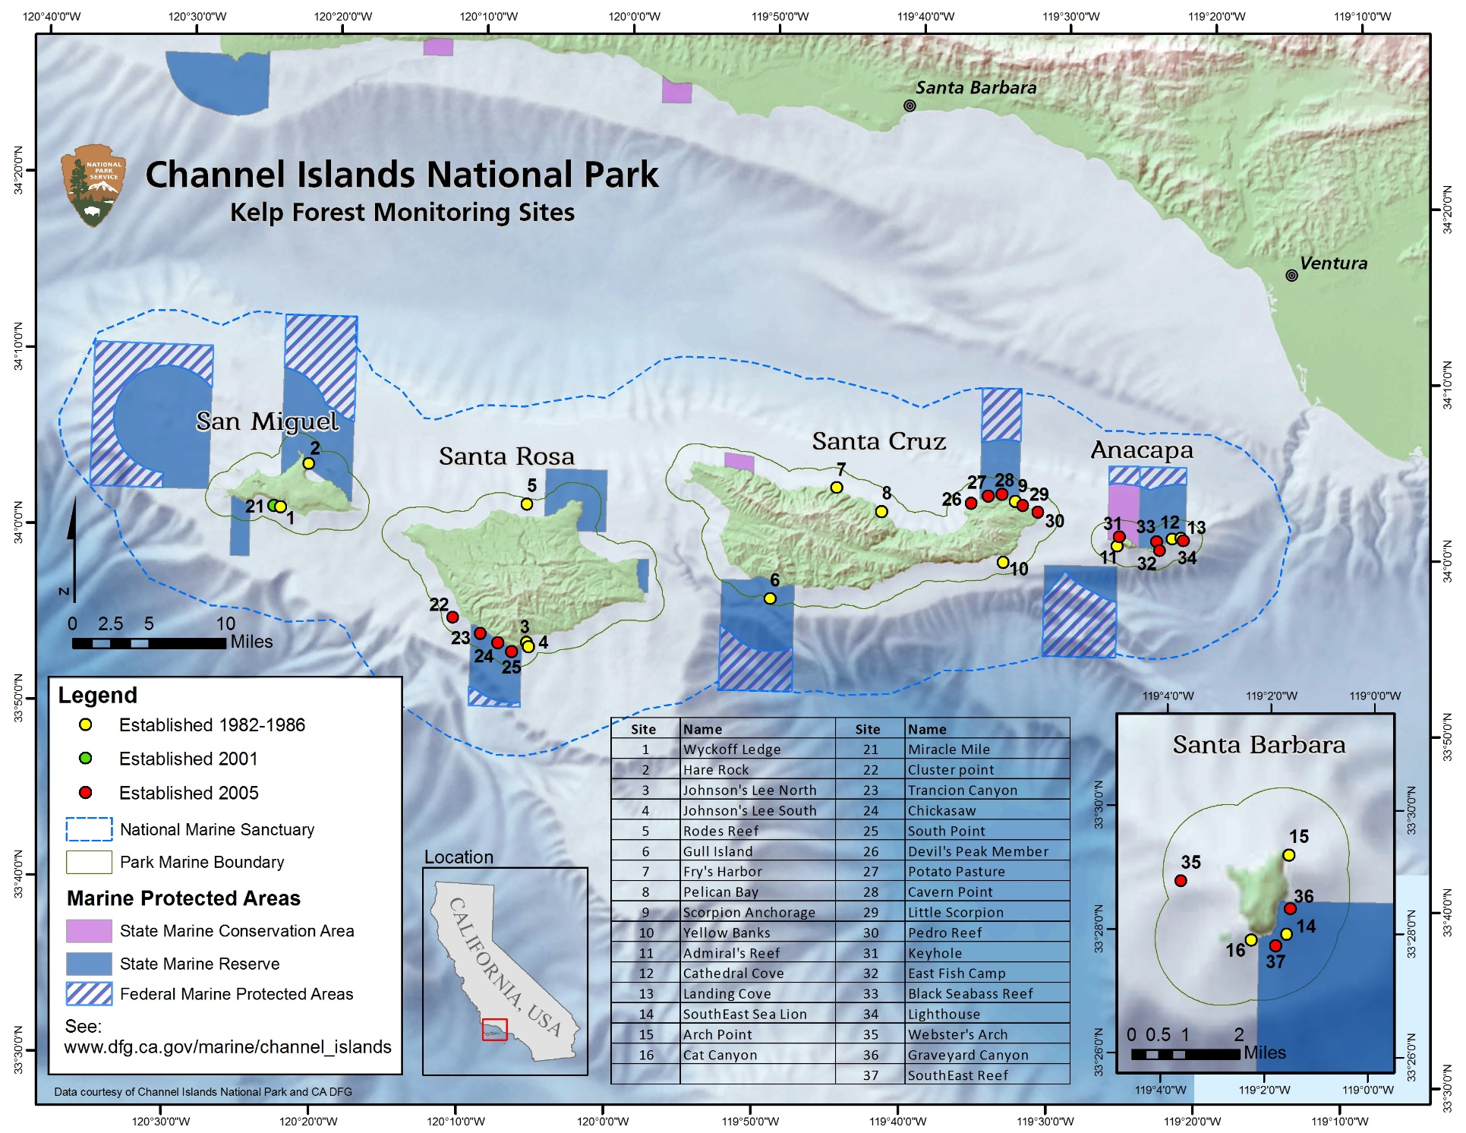
Notes:
Here again is our map of the park with the KFM sites and MPAs overlaid. Today is all about San Miguel.

Slide 3
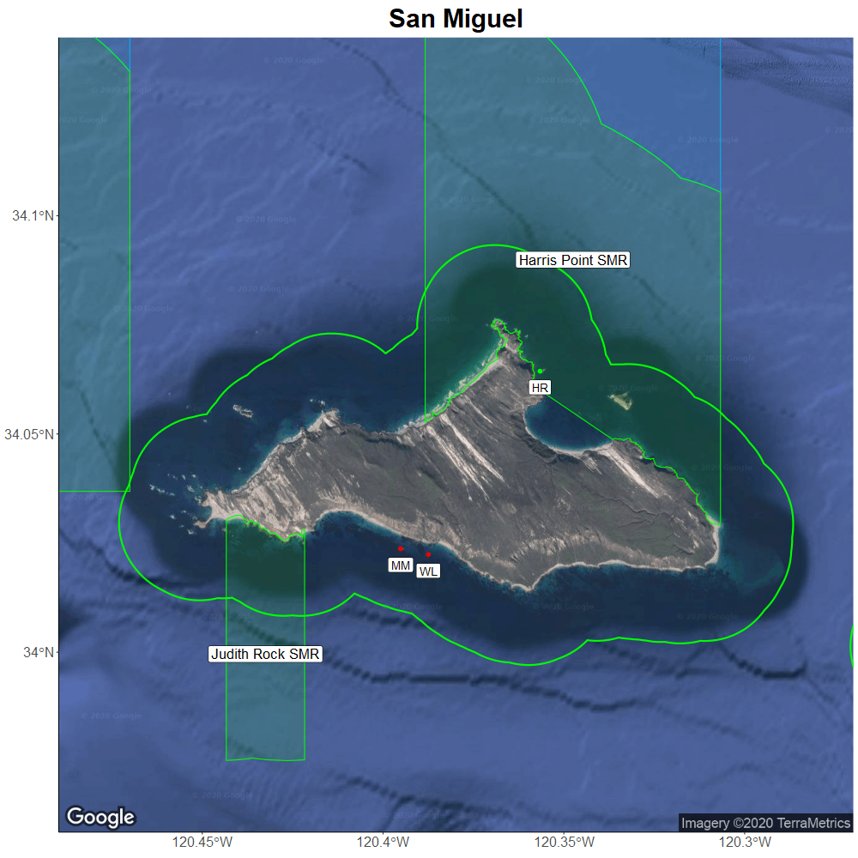
Notes:
Here you can see a closeup of San Miguel with our three current sites.
2 original sites Wyckoff Ledge on the south side and Hare Rock on the north.
Miracle Mile was added in 2001 to monitor red abalone because of the high-density population that existed there
There were no MPA reference sites added in 2005 due to lack of good weather, travel time to the island, and general time to conduct the seasons monitoring
San Miguel is also a cold-water island, typically surveyed towards the end of our season when conditions are best, and water is warmest
Because of these factors, it is hard to do the type of statistics we have been focusing on with our trend report, so San Miguel is largely ignored.
Despite this, we still want to discuss what has been happening at San Miguel as we feel it is significant

Slide 4
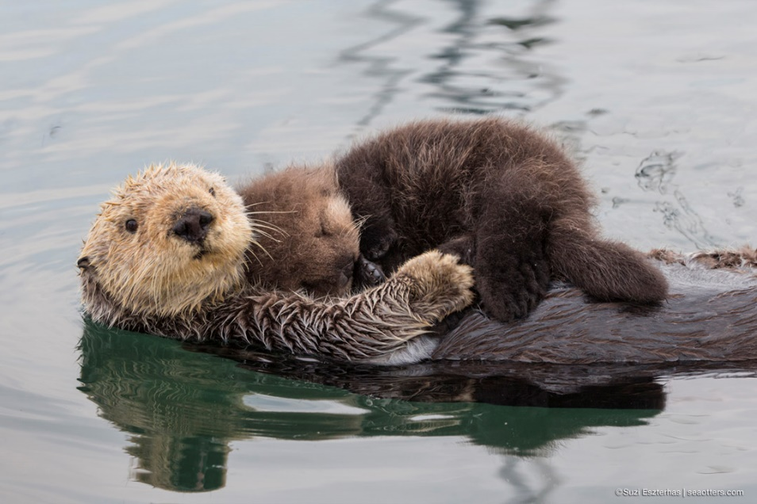
Urchin Predators
Historic
Sea otters (extirpated)
Current
Humans (target red urchins)
Sheephead (low densities)
Sea stars (SSWD)
Not at San Miguel
Spiny lobster
Notes:
San Miguel's community structure looks more like Northern California than it does Southern California, where the major urchin predators have historically been sea otters and sea stars.
By the 1850s, sea otters had been nearly eradicated from California (source http://www.iws.org/CISProceedings/6th_CIS_Proceedings/Erlandson_et_al.pdf page 11 top right)
Currently the three urchin predators at San Miguel are sea stars, humans and sheephead
Humans only target red sea urchins past 3.5 inches
Sheephead densities and biomass are rather low compared to the other channel islands
CA spiny lobster are not present at San Miguel
This leaves just sea stars and a few sheephead to predate on purple sea urchins at San Miguel Island
UNTIL

Slide 5
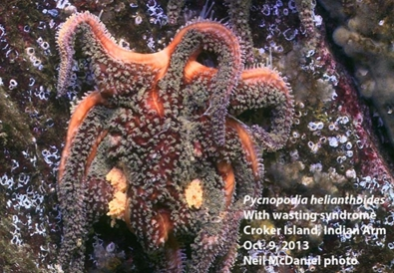
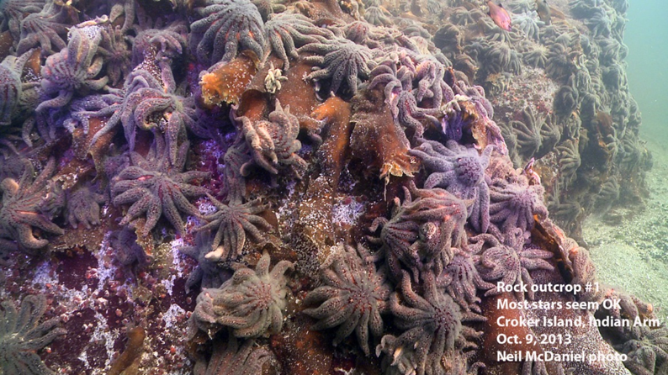
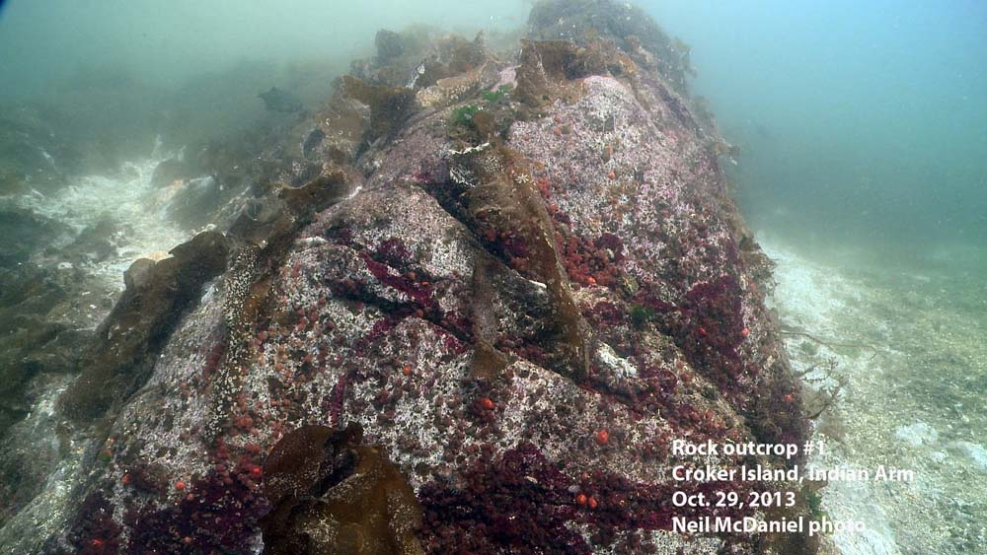
Sea star wasting disease (SSWD)
Notes:
The onset of SSWD in 2013. The first evidence of a possible Sea Star wasting event came in June when Long-Term Monitoring sites in Washington (monitored by Olympic National Park) recorded diseased stars with percent affected rates between 3-26%. Symptoms of wasting disease in a few Pisaster ochraceus were also noted in August at an intertidal Biodiversity site in Southeast Alaska. Articles from British Columbia, Canada report sightings of dozens of dead sea stars (notably Pycnopodia helianthoides) beginning in September, not far from Vancouver. During this period in Summer 2013, observations were also made throughout southern and central, and later northern California, of wasting in several star species. However, it’s likely that the onset of SSWD occurred prior to these observations at less than detectable levels in 2012.

Slide 6

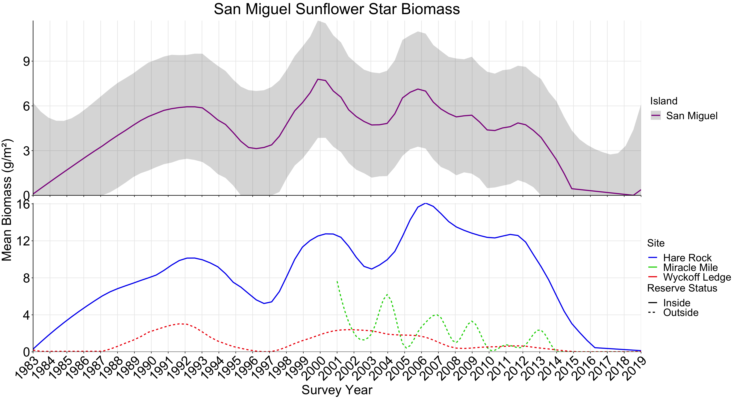
Populations were spatially and temporally dynamic – differences between sites and over time
Mass die-off around 2013
Notes:
So with that background, here’s a plot of mean biomass for Sunflower stars at San Miguel since the beginning of the kelp forest monitoring program. The first thing you should notice is that prior to 2013, these populations did fluctuate – and you’ll notice similar time periods in the coming graphs. There were also large differences in density between sites at SMI, which is consistent with much of central California during that period as well. However, what we see beginning in 2013 is a dropoff that’s not noticeably steeper than other declines (again, most obvious in the line from Hare Rock), but results in complete loss of this species at SMI.
Another thing to know about these graphs is that we smoothed these lines using a non-parametric process called locally weighted scatterplot smoothing – which essentially uses a kernel approach where it considers the years prior and following the datapoint. One of the artifacts of this approach is that at the end of a timeseries, there is not future data to incorporate into the smoothing model, and so it’s not uncommon to see a slight uptick at the latest data point – and that’s what’s occurring here. There were no Pycnopodia observed in 2019 by KFM.
Next, Dan is going to take us down the food chain -

Slide 7
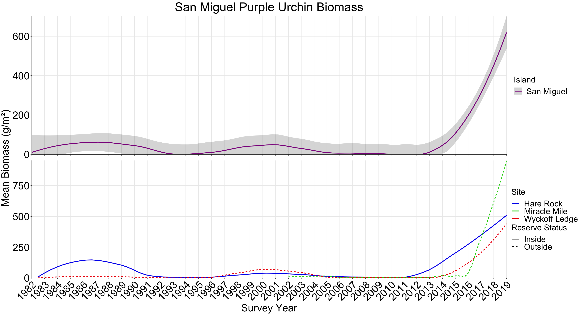
Huge biomass spike with release from predation
Notes:
Dan

Slide 8
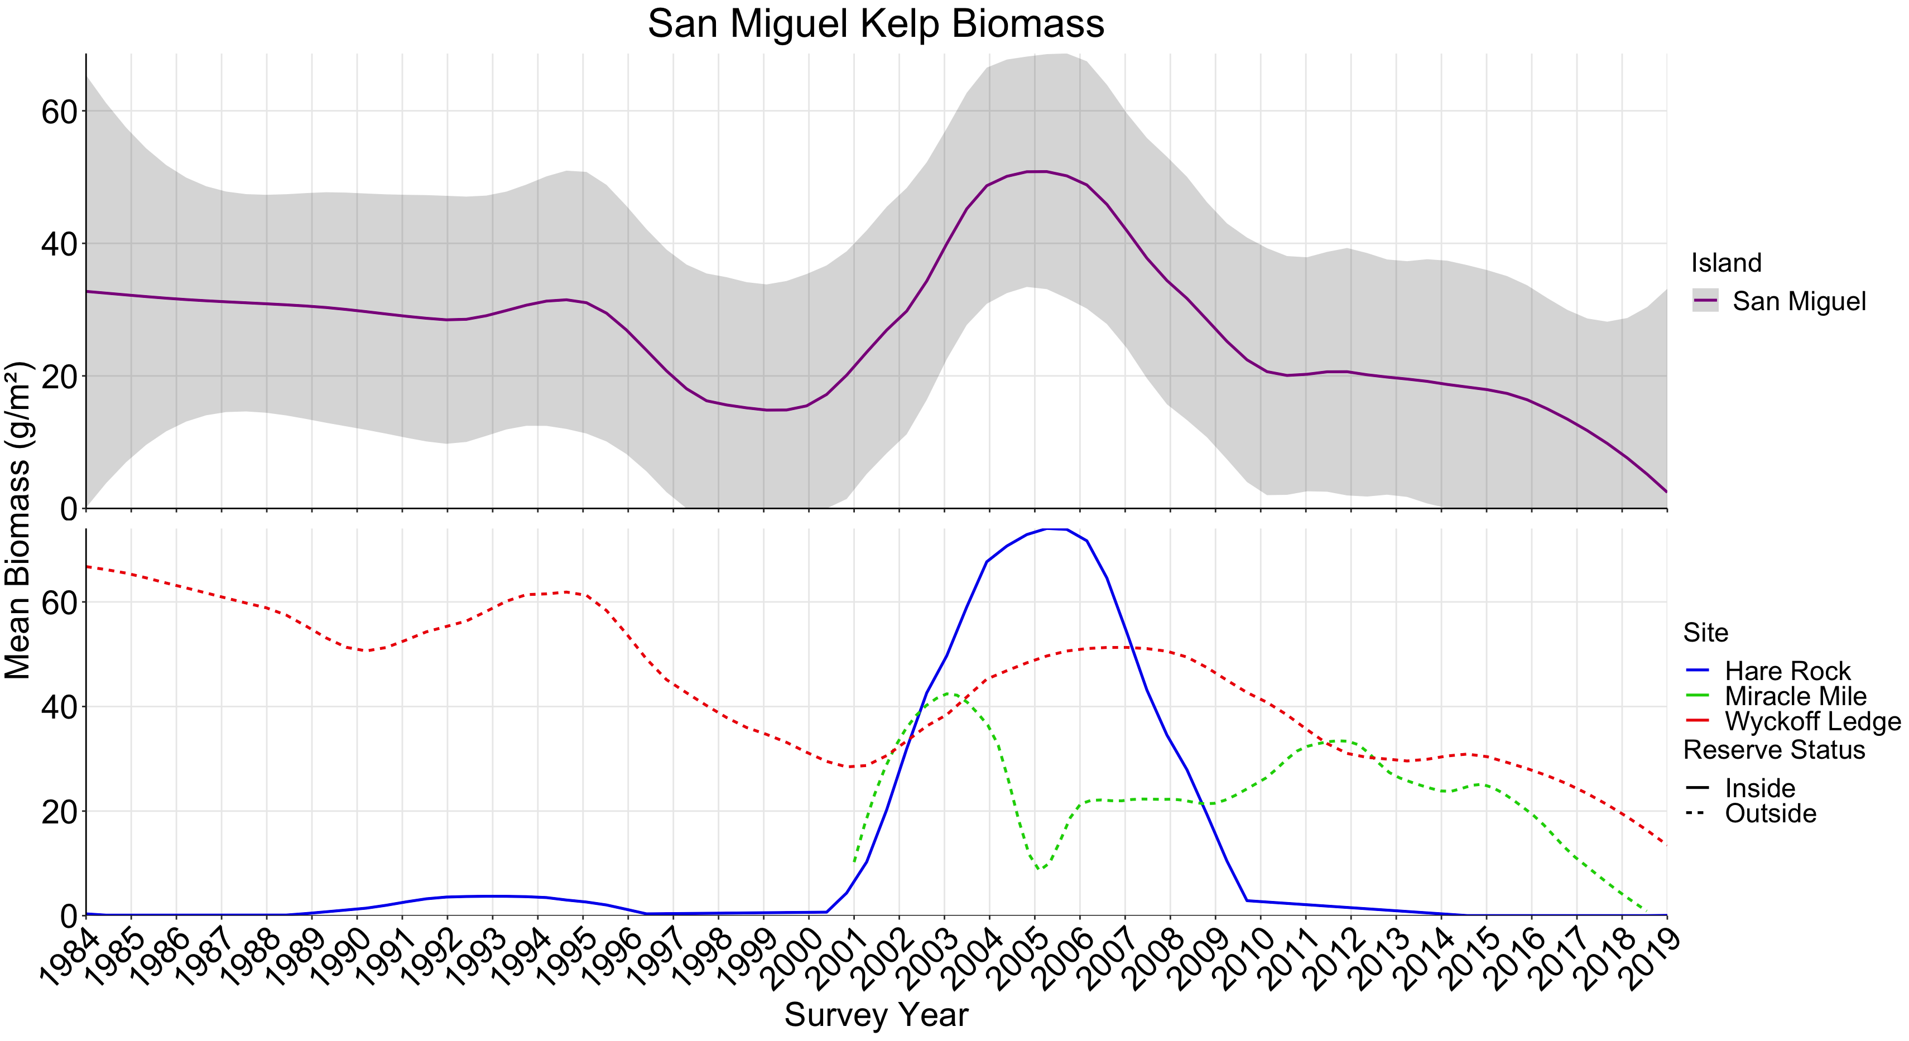

Kelp biomass decrease with increased predation
Notes:
Dan

Slide 9
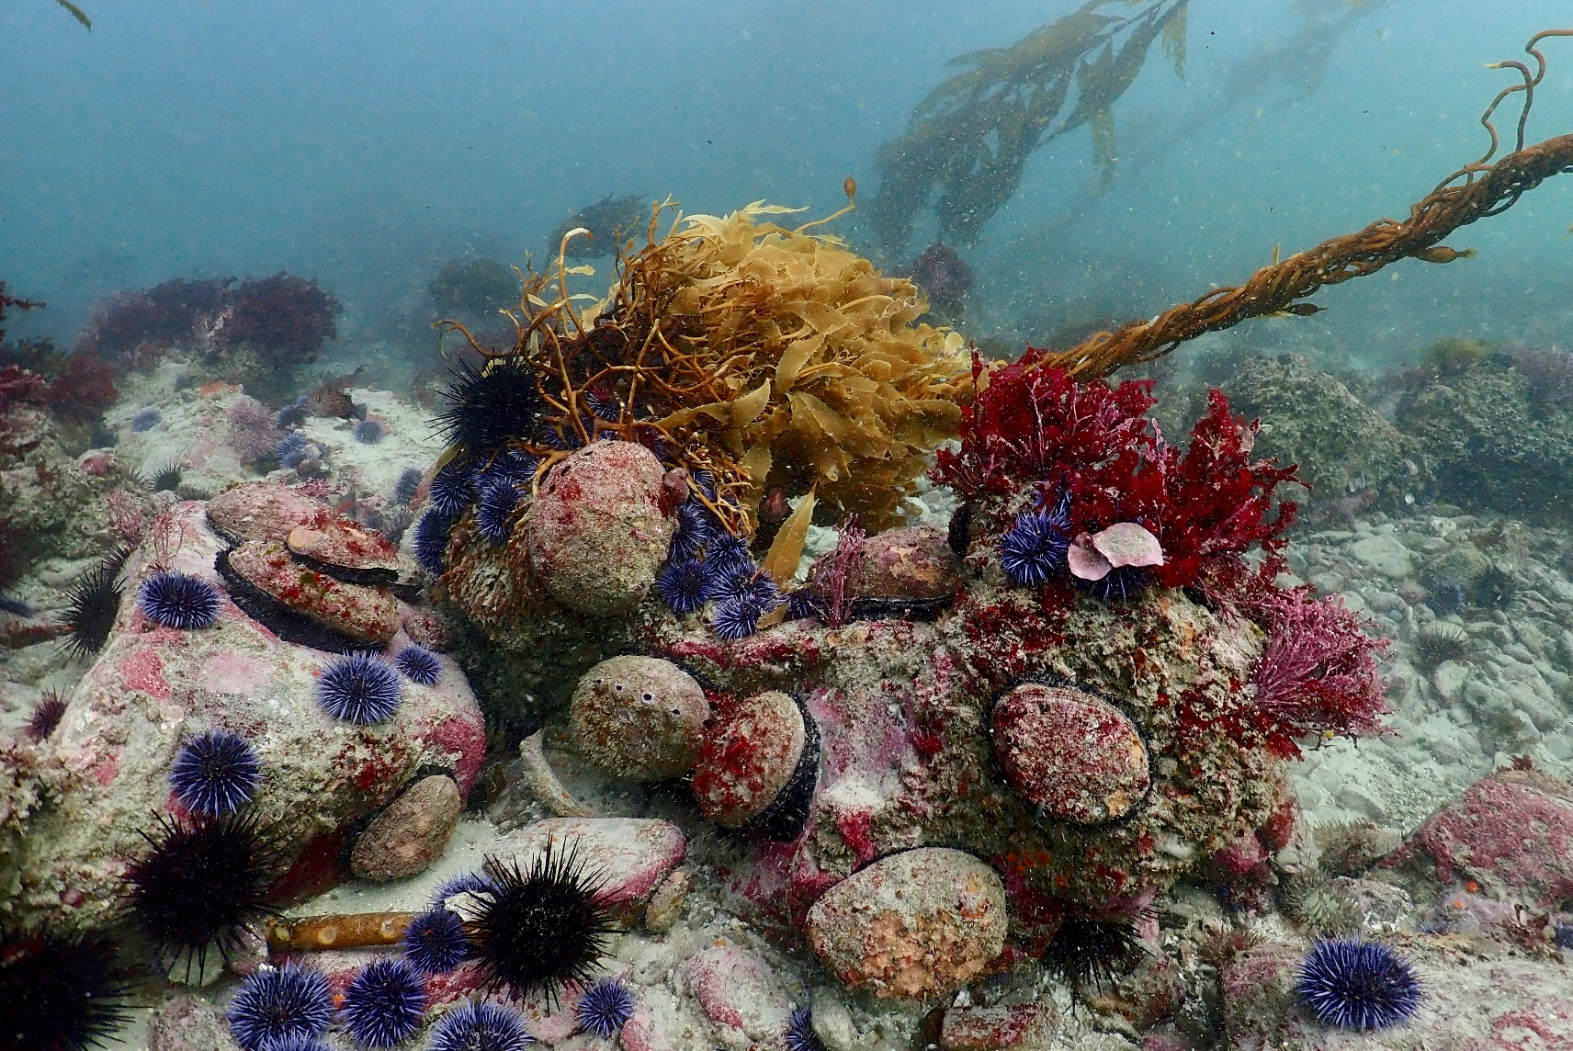
Abalone and urchins competing
Notes:
San Miguel historically has had dense kelp forests and highest densities of red abalone outside of the northern california coast. Our site Miracle Mile at San Miguel Island was established in 2001 was chosen specifically because it had high densities of abalone compared to other San Miguel sites. With the relatively recent disappearance of the sunflower star, the increase in biomass of purple urchins, abalone have had to compete with urchins while foraging for giant kelp. This picture above shows urchins, primarily purple urchins alongside red abalone competing for a kelp holdfast.
Laurie

Slide 10
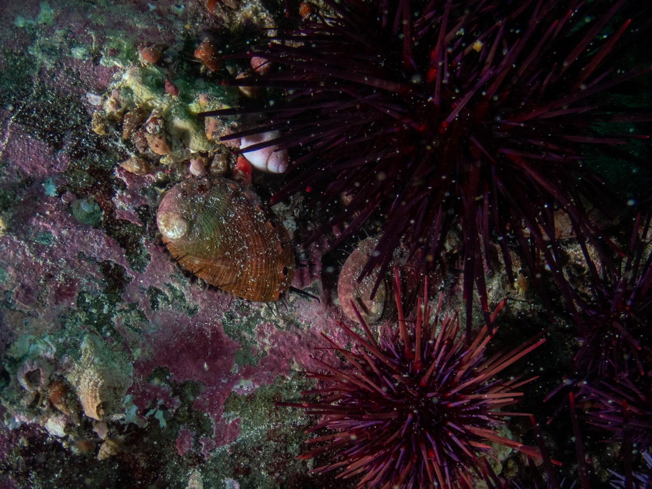
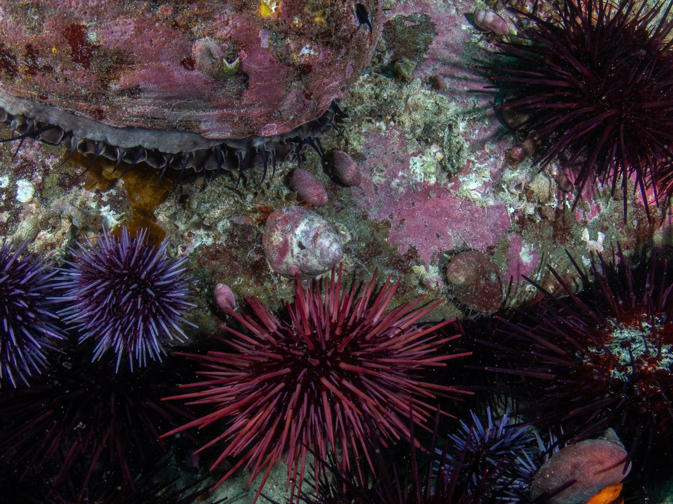
Juvenile abalone emerge to forage
Notes:
With the decrease in available food you can see in this photo that juvenile red abalone start emerging from crevice habitat to forage. This led to na shift in the overall size frequency towards smaller size classes of red abalone. Usually these smaller sized abalone would not be recorded during sampling because they are small, cryptic and not as visible during our non invasive sampling techniques.
Laurie

Slide 11
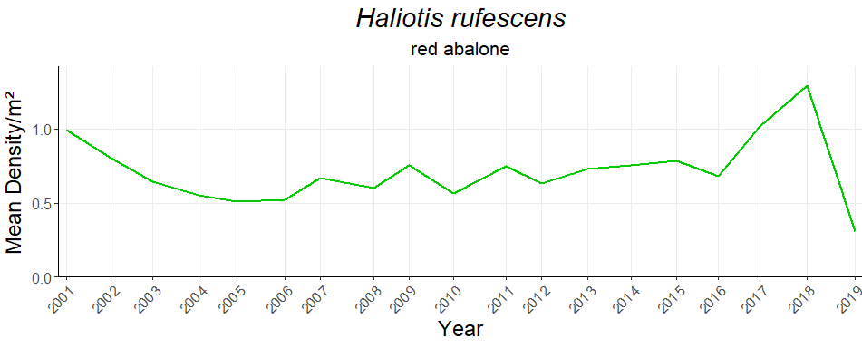
Highest densities of red abalone seen on the project in 2018 followed by lowest densities in 2019
Notes:
We also saw a drop in the density of abalone in 2019 after recording our highest densities in 2018, which is shown on the graph above here. The 2018 high densities were likely driven by the emergence of juveniles from crevice habitat that I talked about in the last slide. In 2018 at Miracle Mile, we were seeing about 1.3 abalone per square meter, which for our site is around 2600 abalone. In 2019, we recorded less than .3 red abalone per square meter which is around 600 abalone.
Laurie
2018 density was 1.3 which is about 2600 abalone on our site
2019 density was .3 which is about 600 abalone on our site

Slide 12
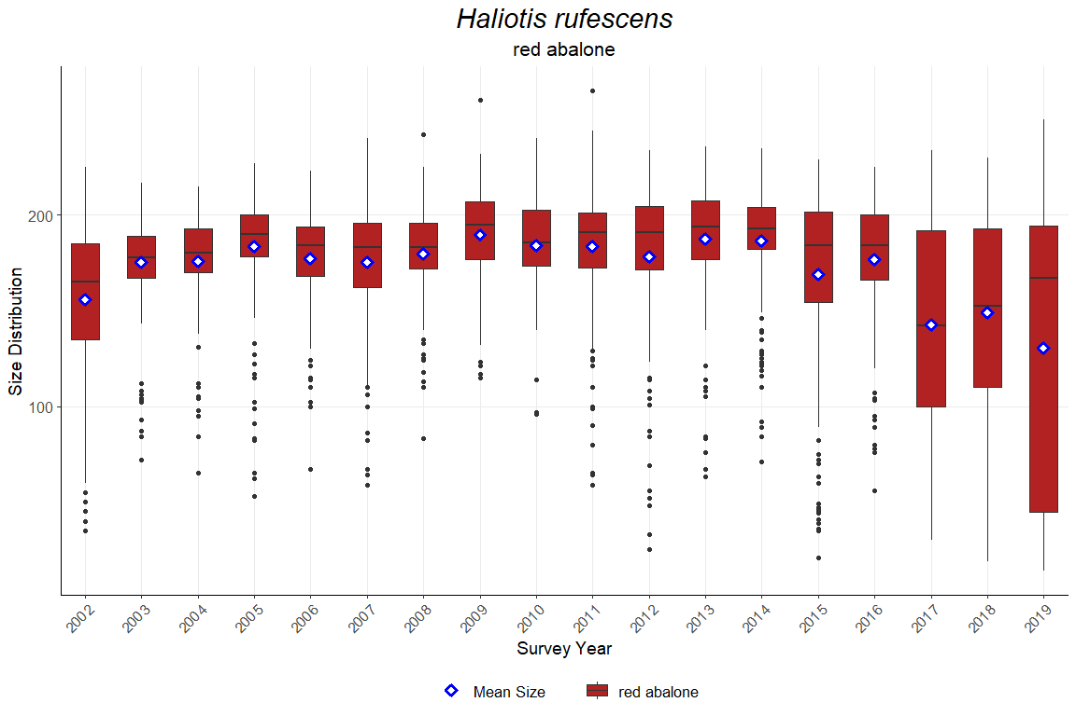
Notes:
Here you can see the size distribution of red abalone with a blue diamond marking the mean size. In 2017 you start to see a change in the size distribution that shifts towards smaller size classes and smaller mean size.
Laurie

Slide 13
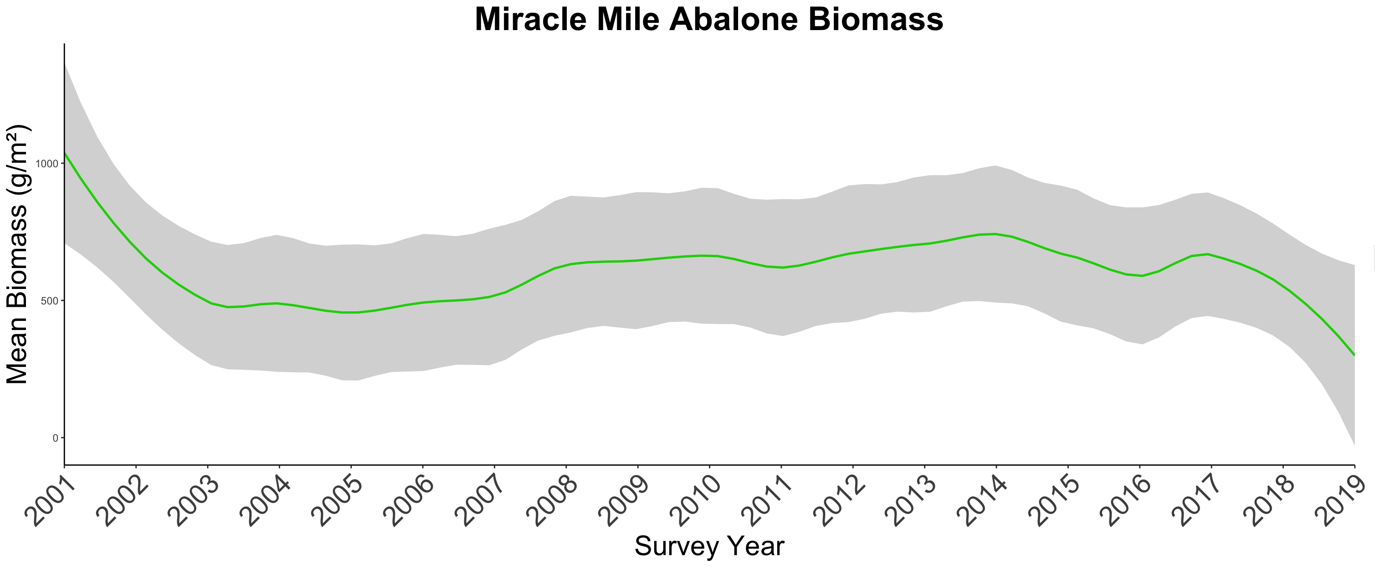

Overall decrease in abalone biomass at Miracle Mile
Notes:
With the decrease in biomass of giant kelp, the last couple of years have seen a drastic decrease in the overall biomass of red abalone at Miracle Mile, which you can see in the graph above.
Laurie

Slide 14

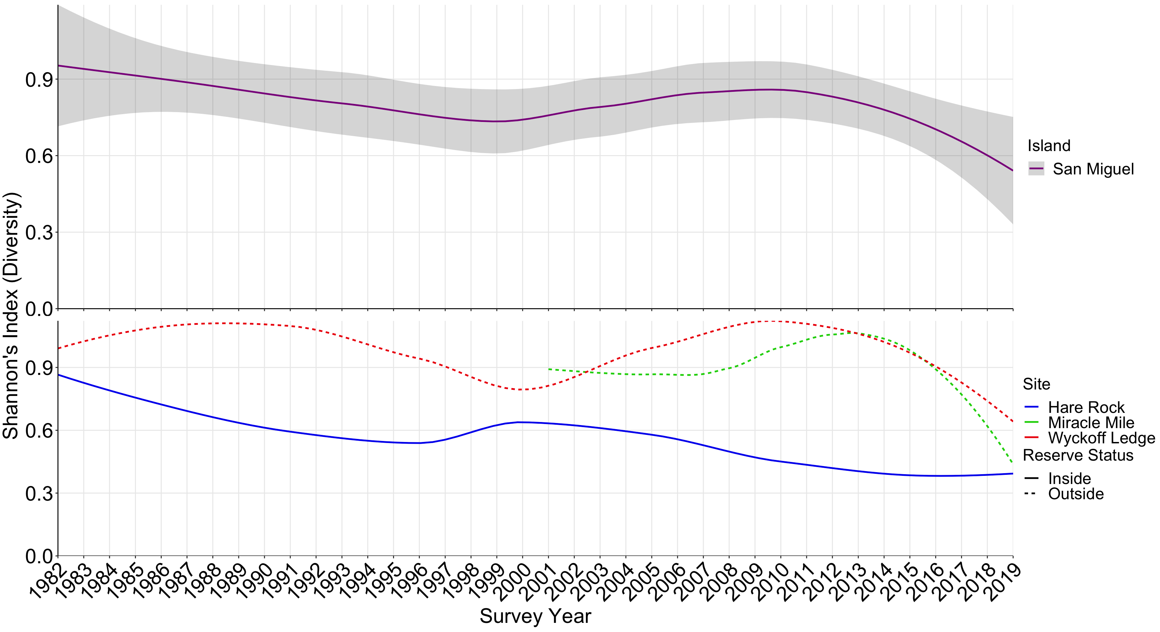
Diversity
Notes:
Tim
And the consequence of all of these factors is Diversity goes down

Slide 15
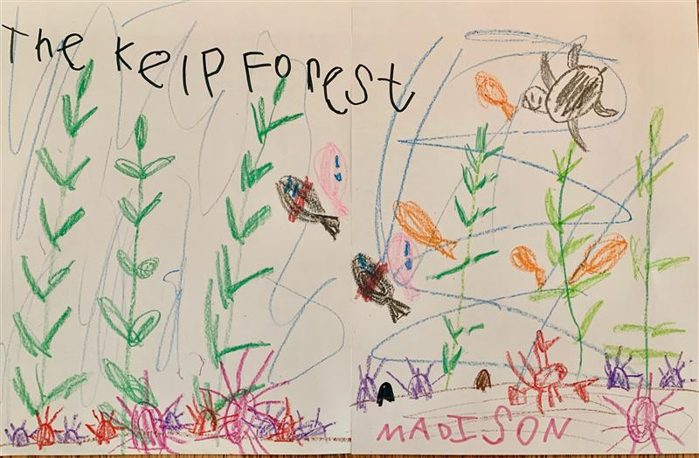
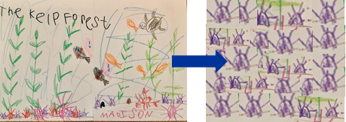
Conclusions
Notes:
Trophic cascades we talked about last week – make the point that not only do trophic cascades regulate community structure, but environmental and epidiemiological conditions can also interact with these cascades and create indirect effects.
Urchin disease up north -

Slide 16
Conclusions
Loss of key predators leaves urchin populations unchecked (trophic cascade)
Loss of other important herbivores (abalone) due to intense competition
Continuous sampling is extremely important
2021 will be a crucial sampling year
Potential for return – already observed in AK/BC/WA
Notes:
Trophic cascades we talked about last week – make the point that not only do trophic cascades regulate community structure, but environmental and epidiemiological conditions can also interact with these cascades and create indirect effects.
Urchin disease up north -

Slide 17
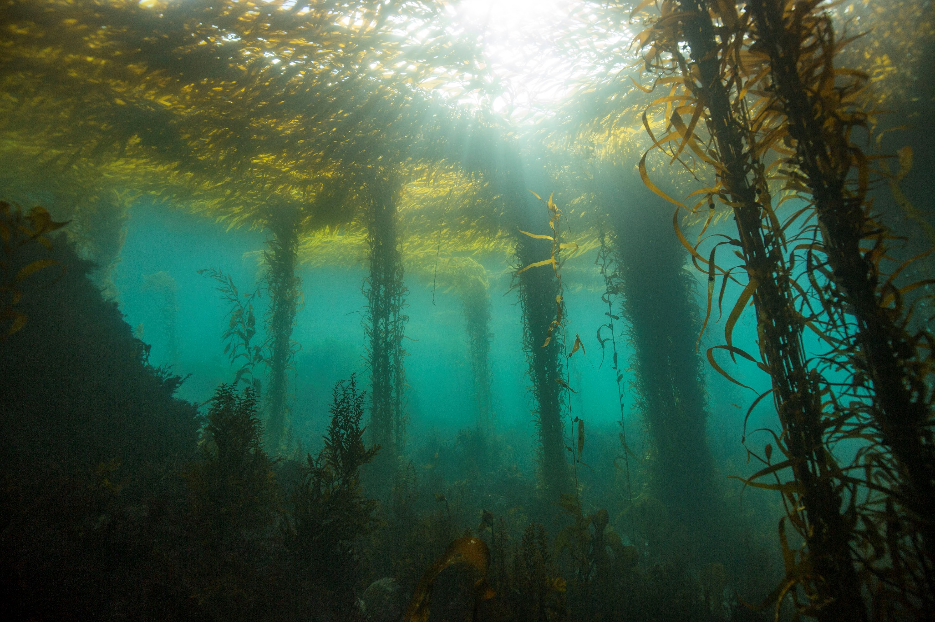
Michael Langhans
Notes:
So when we think about kelp forests, we often imagine long, healthy stipes

Slide 18
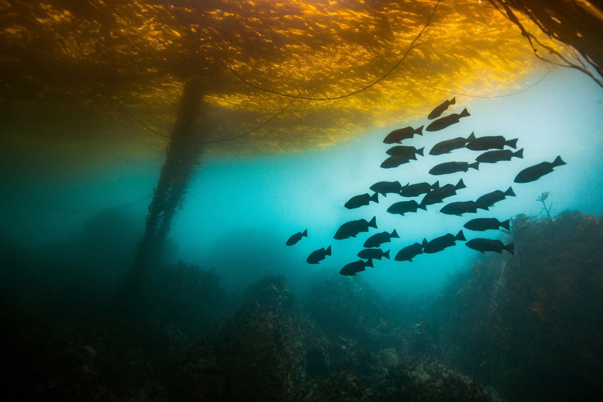
Michael Langhans
Notes:
And dense canopies teeming with life

Slide 19
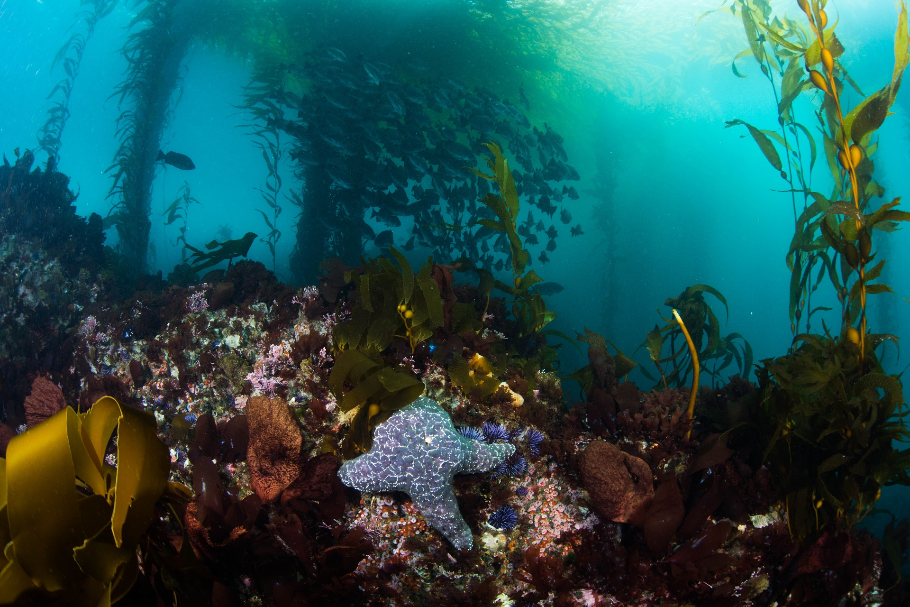

Slide 20
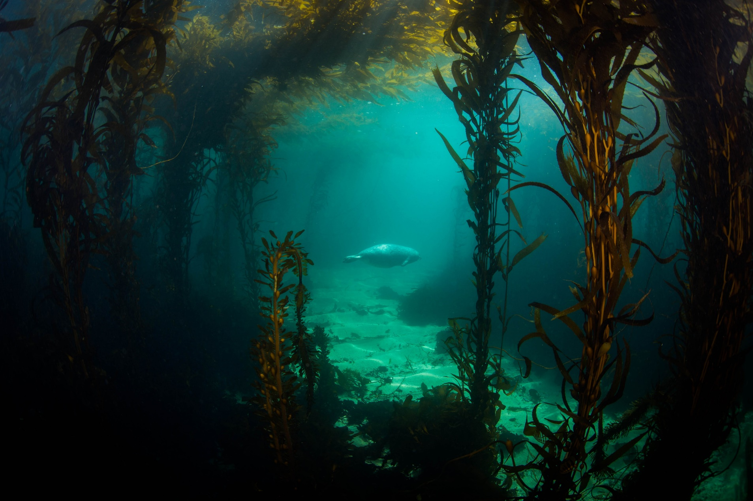
Michael Langhans
Notes:
But unfortunately what we are seeing now, in the absence of key predators such as otters and sunflower stars…

Slide 21
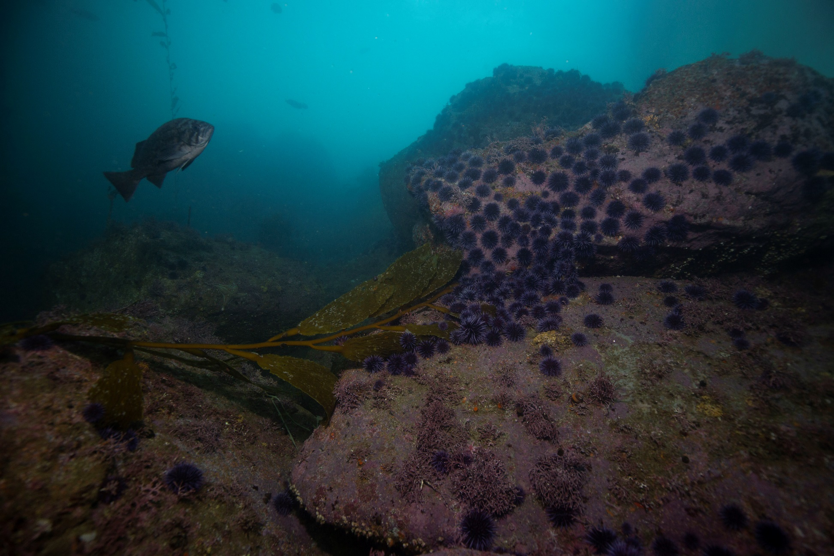
Michael Langhans
Notes:
Is an explosion of sea urchin populations

Slide 22
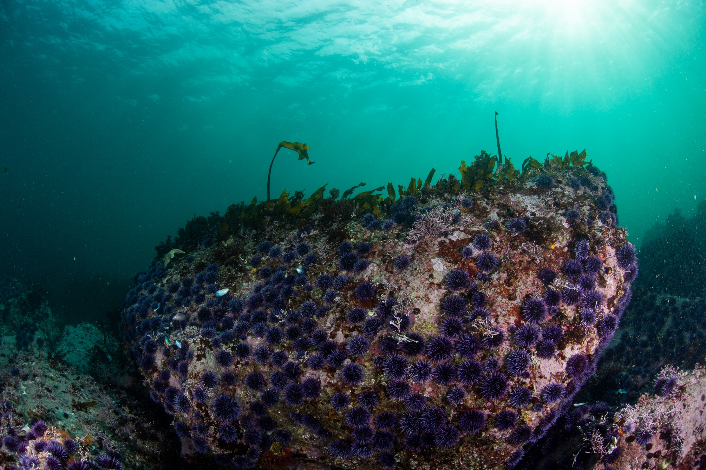
Michael Langhans
Notes:
Which are leaving their crack and crevice habitats--where they previously fed on drift kelp floating in

Slide 23
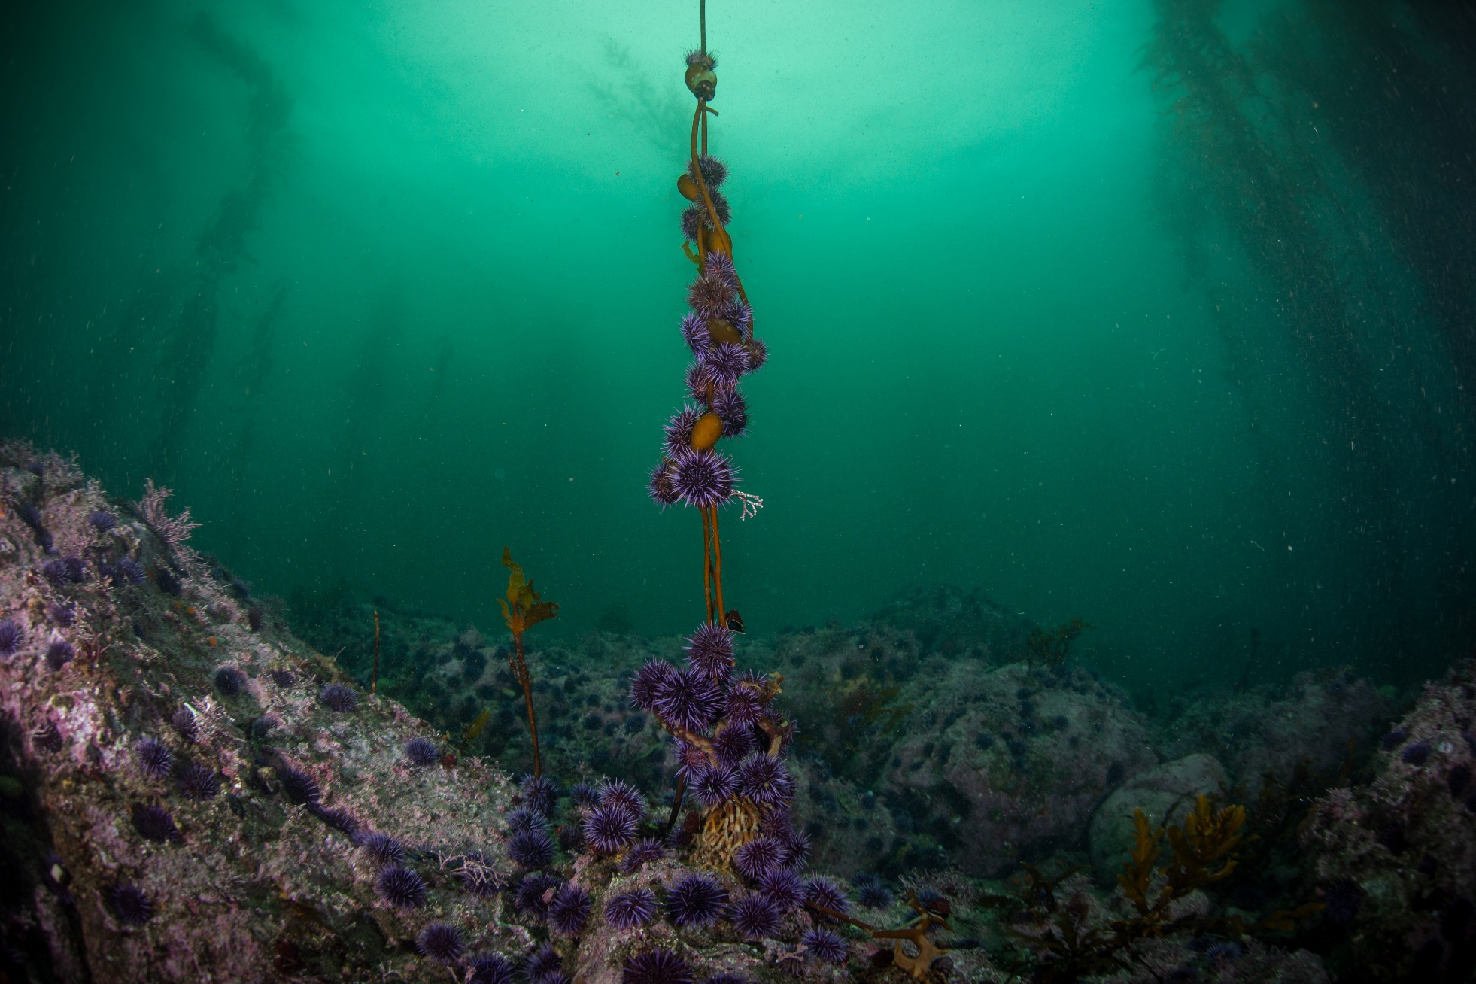
Michael Langhans
Notes:
To actively forage on live kelp

Slide 24
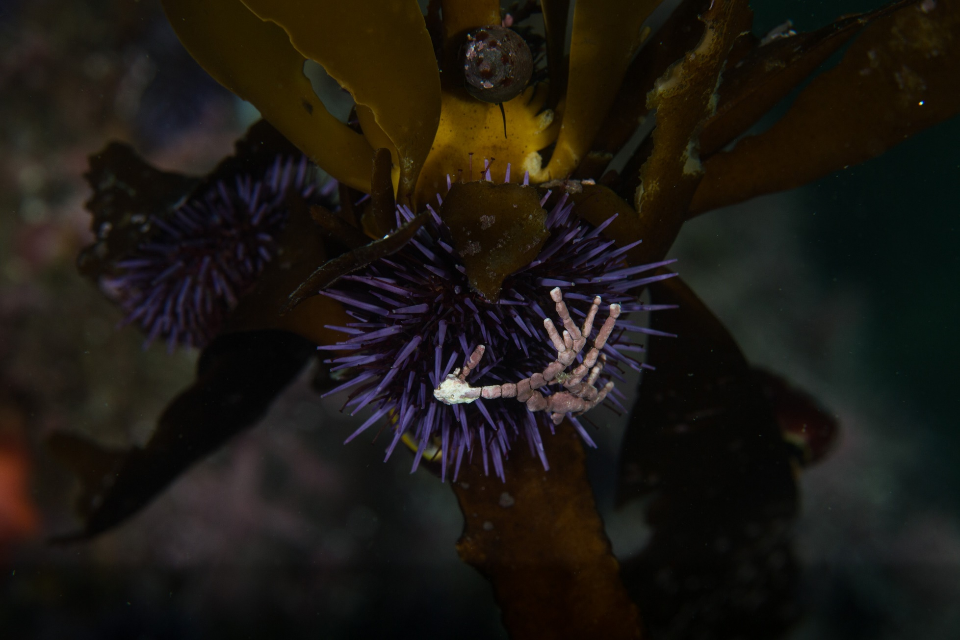
Michael Langhans

Slide 25
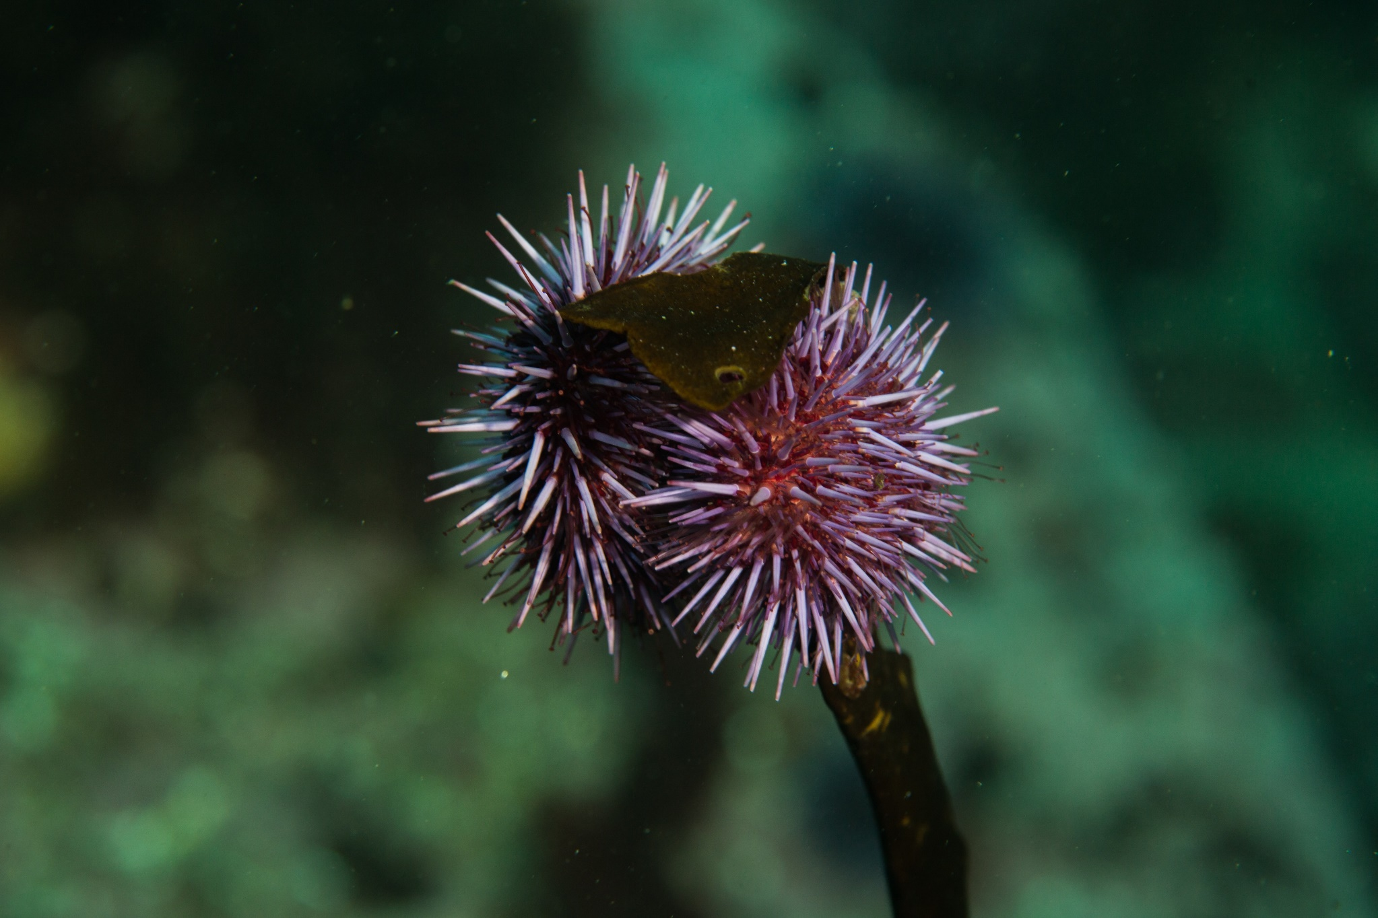
Michael Langhans

Slide 26
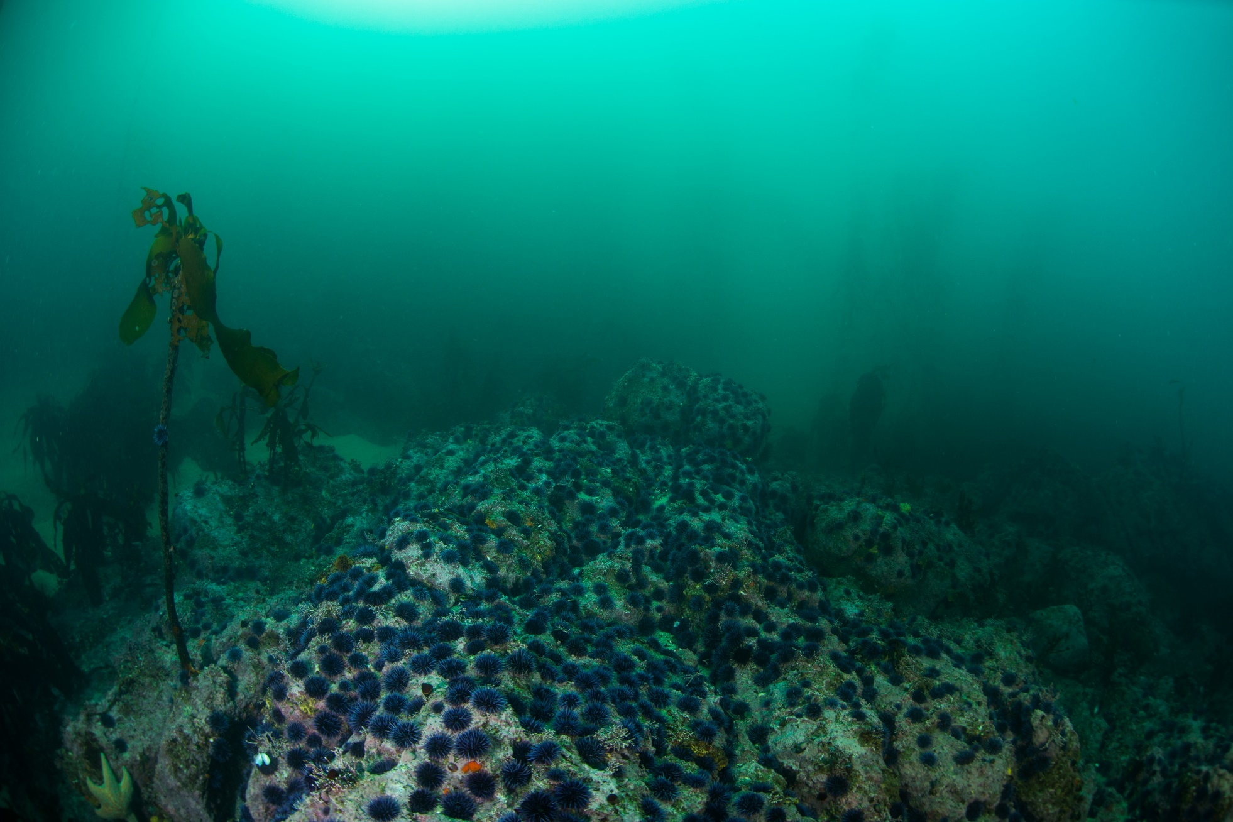
Michael Langhans
Notes:
Which has initiated many phase shifts of kelp forest ecosystems, like the ones present at San Miguel, to barrens

Slide 27
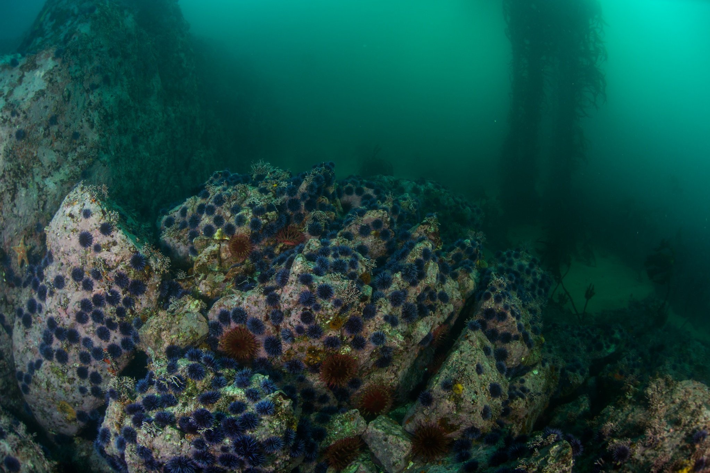
Michael Langhans

Slide 28
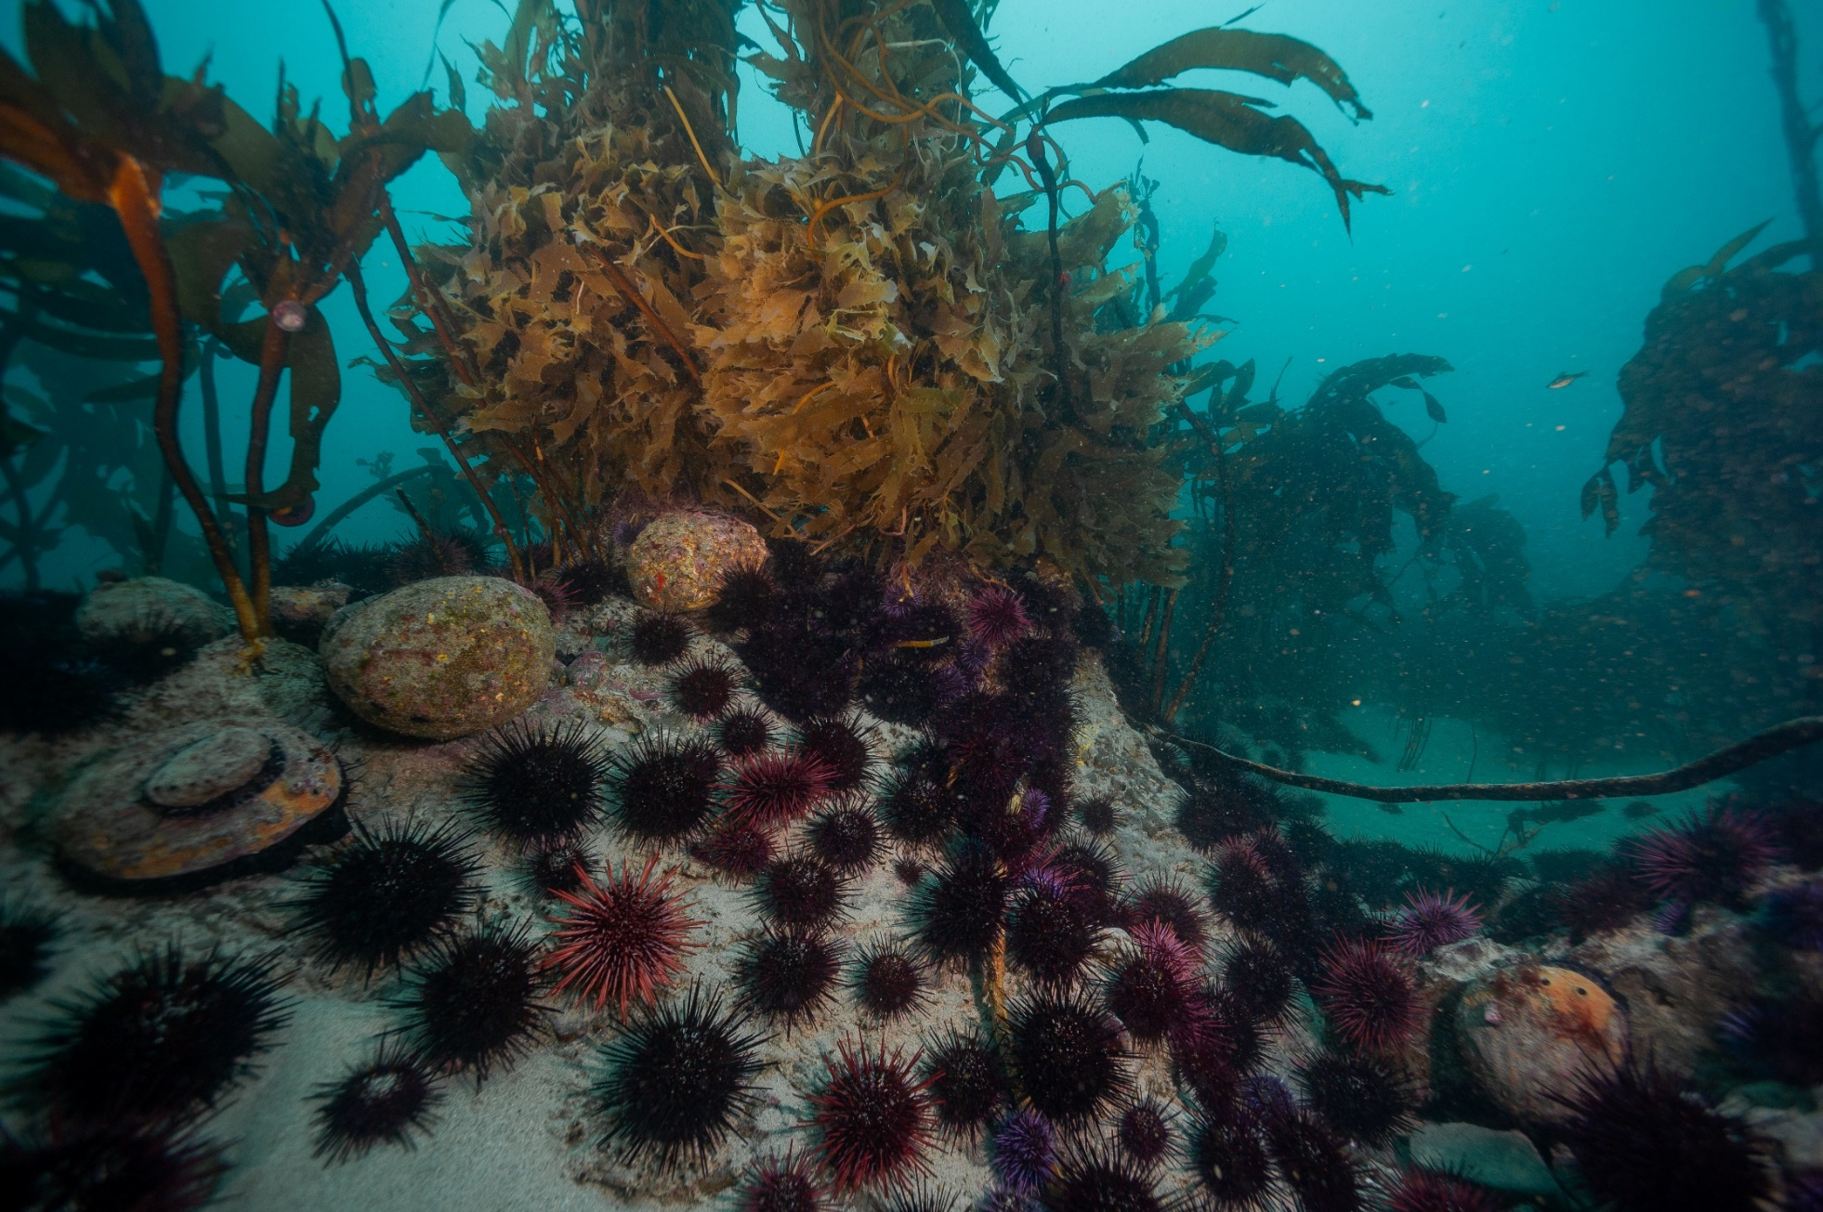
Notes:
And like mentioned before, this poses a significant threat to the abalone populations, which usually reside in cracks and crevices given an abundance of drift kelp

Slide 29
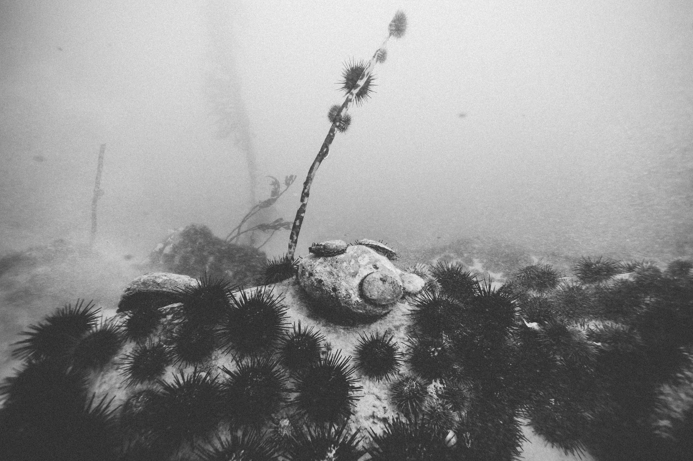
Notes:
But which now have to compete with grazing urchins for food

Slide 30
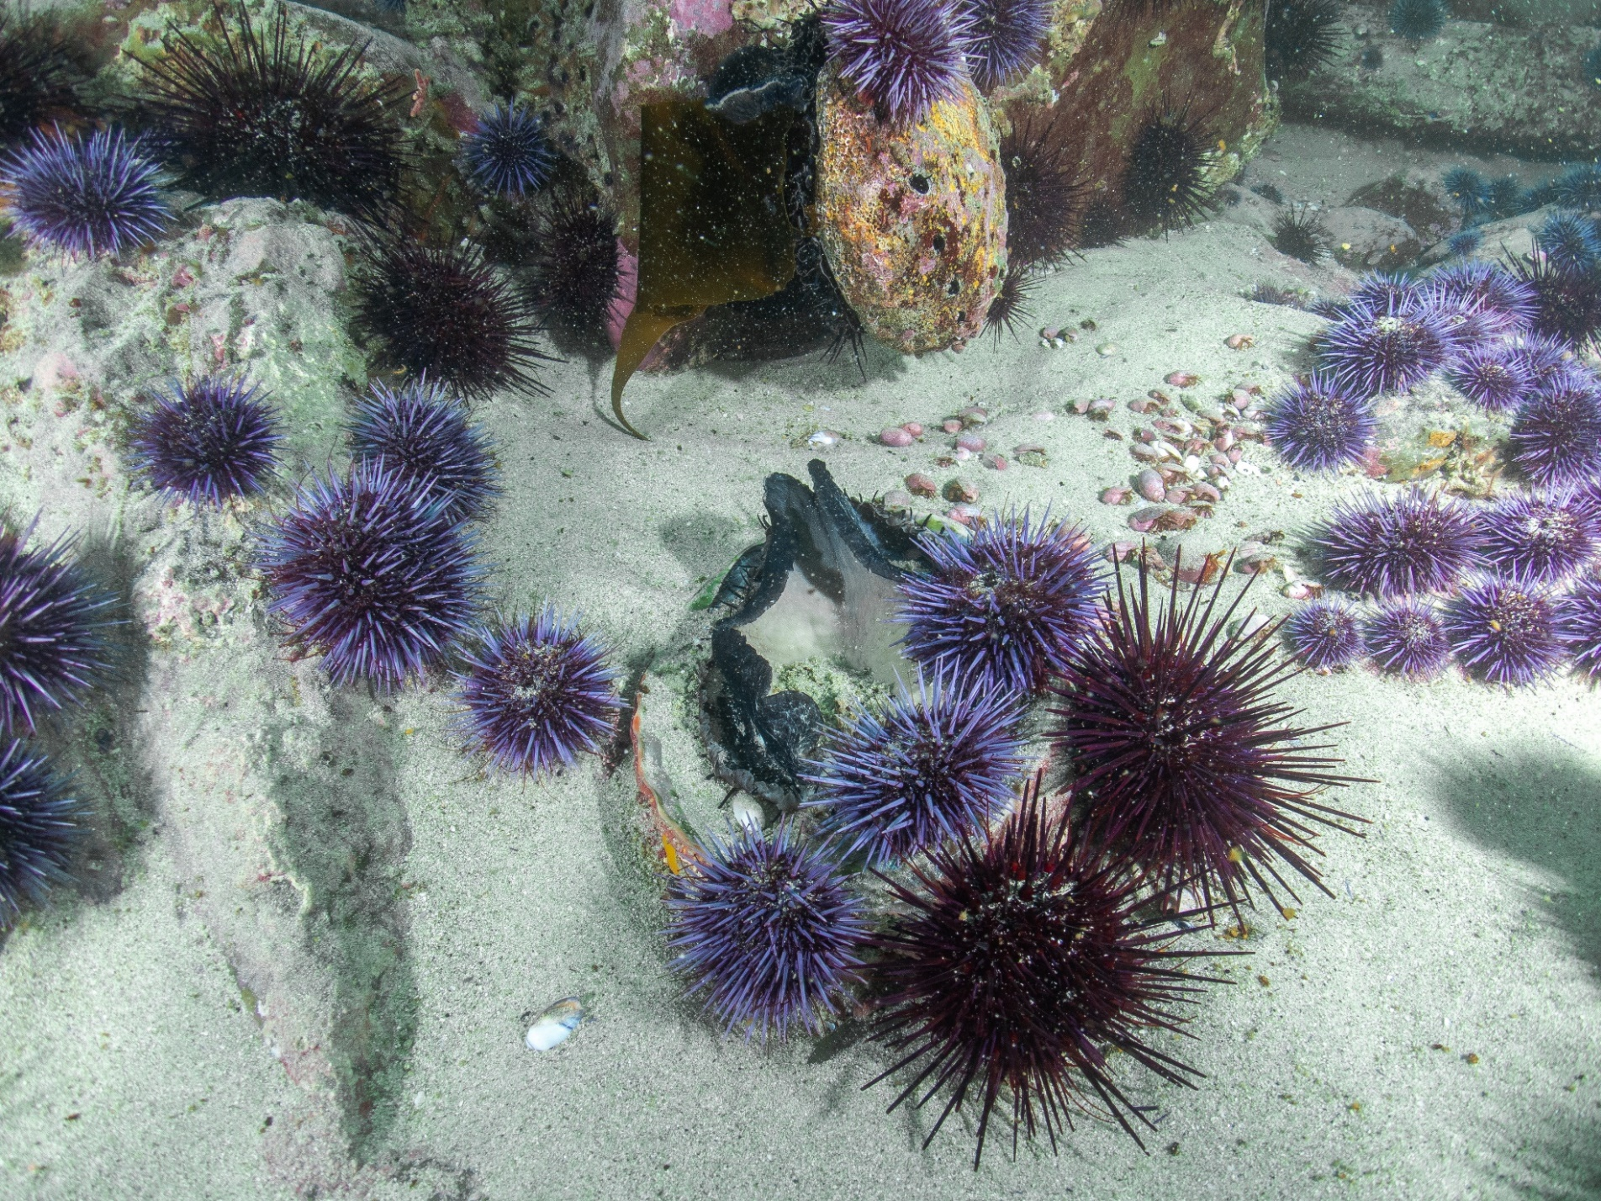
Notes:
And for their survival

Slide 31
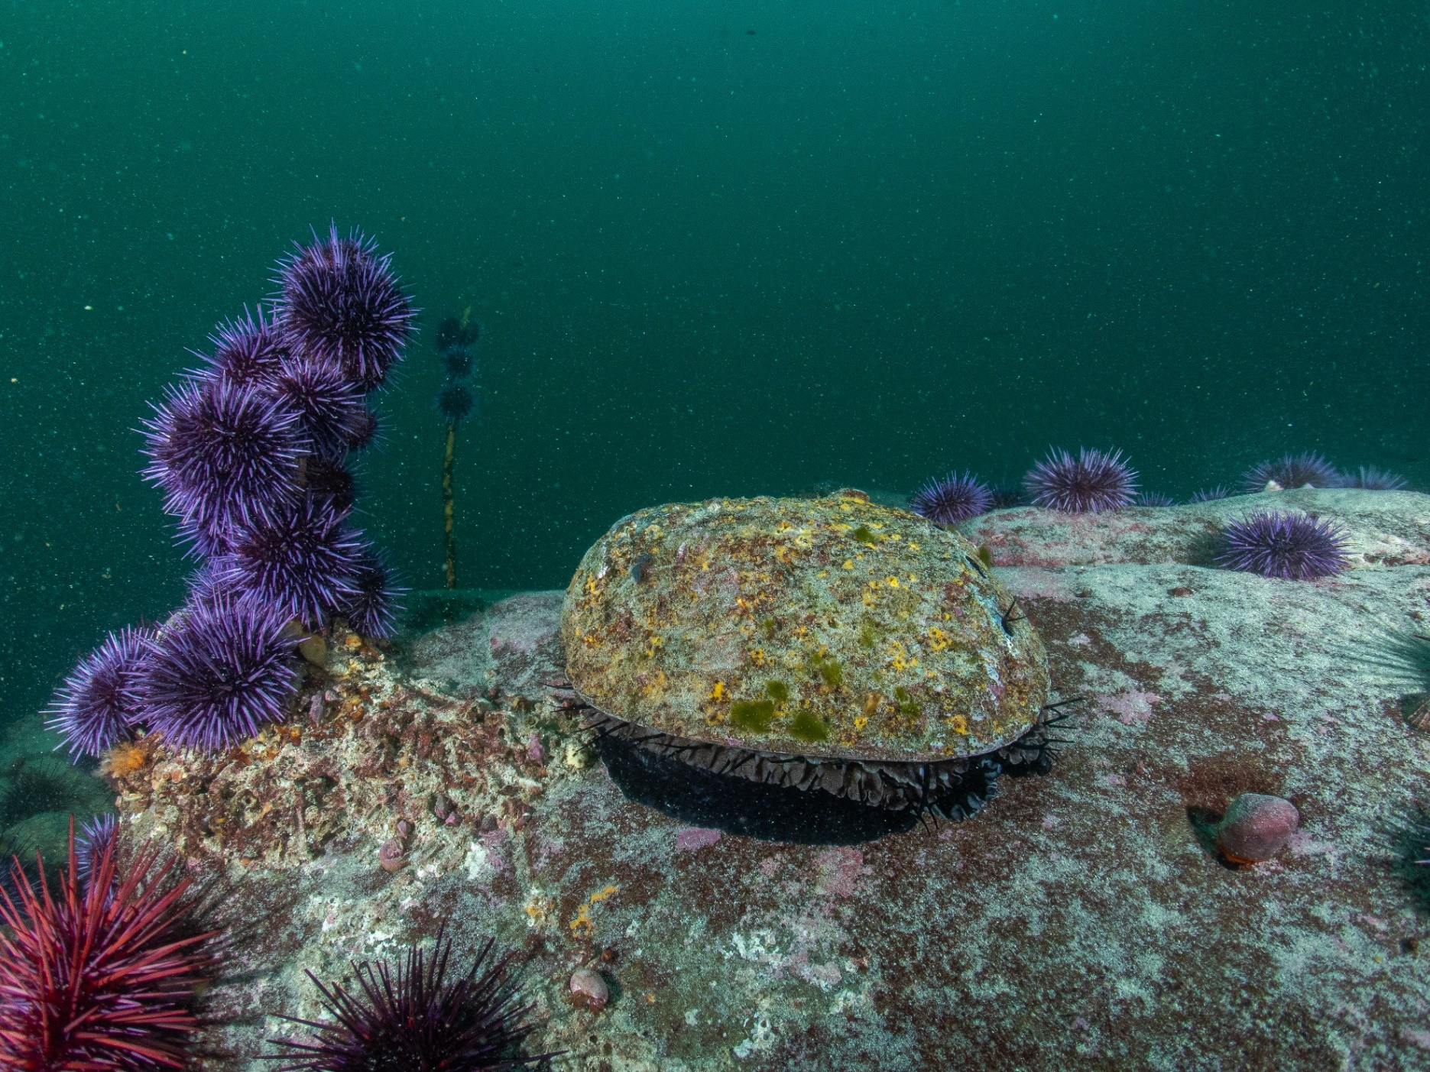
Notes:
Which is why our data reflects a decrease in abalone size frequency, as more and more juveniles leave their protective spaces in search of sustenance

Slide 32
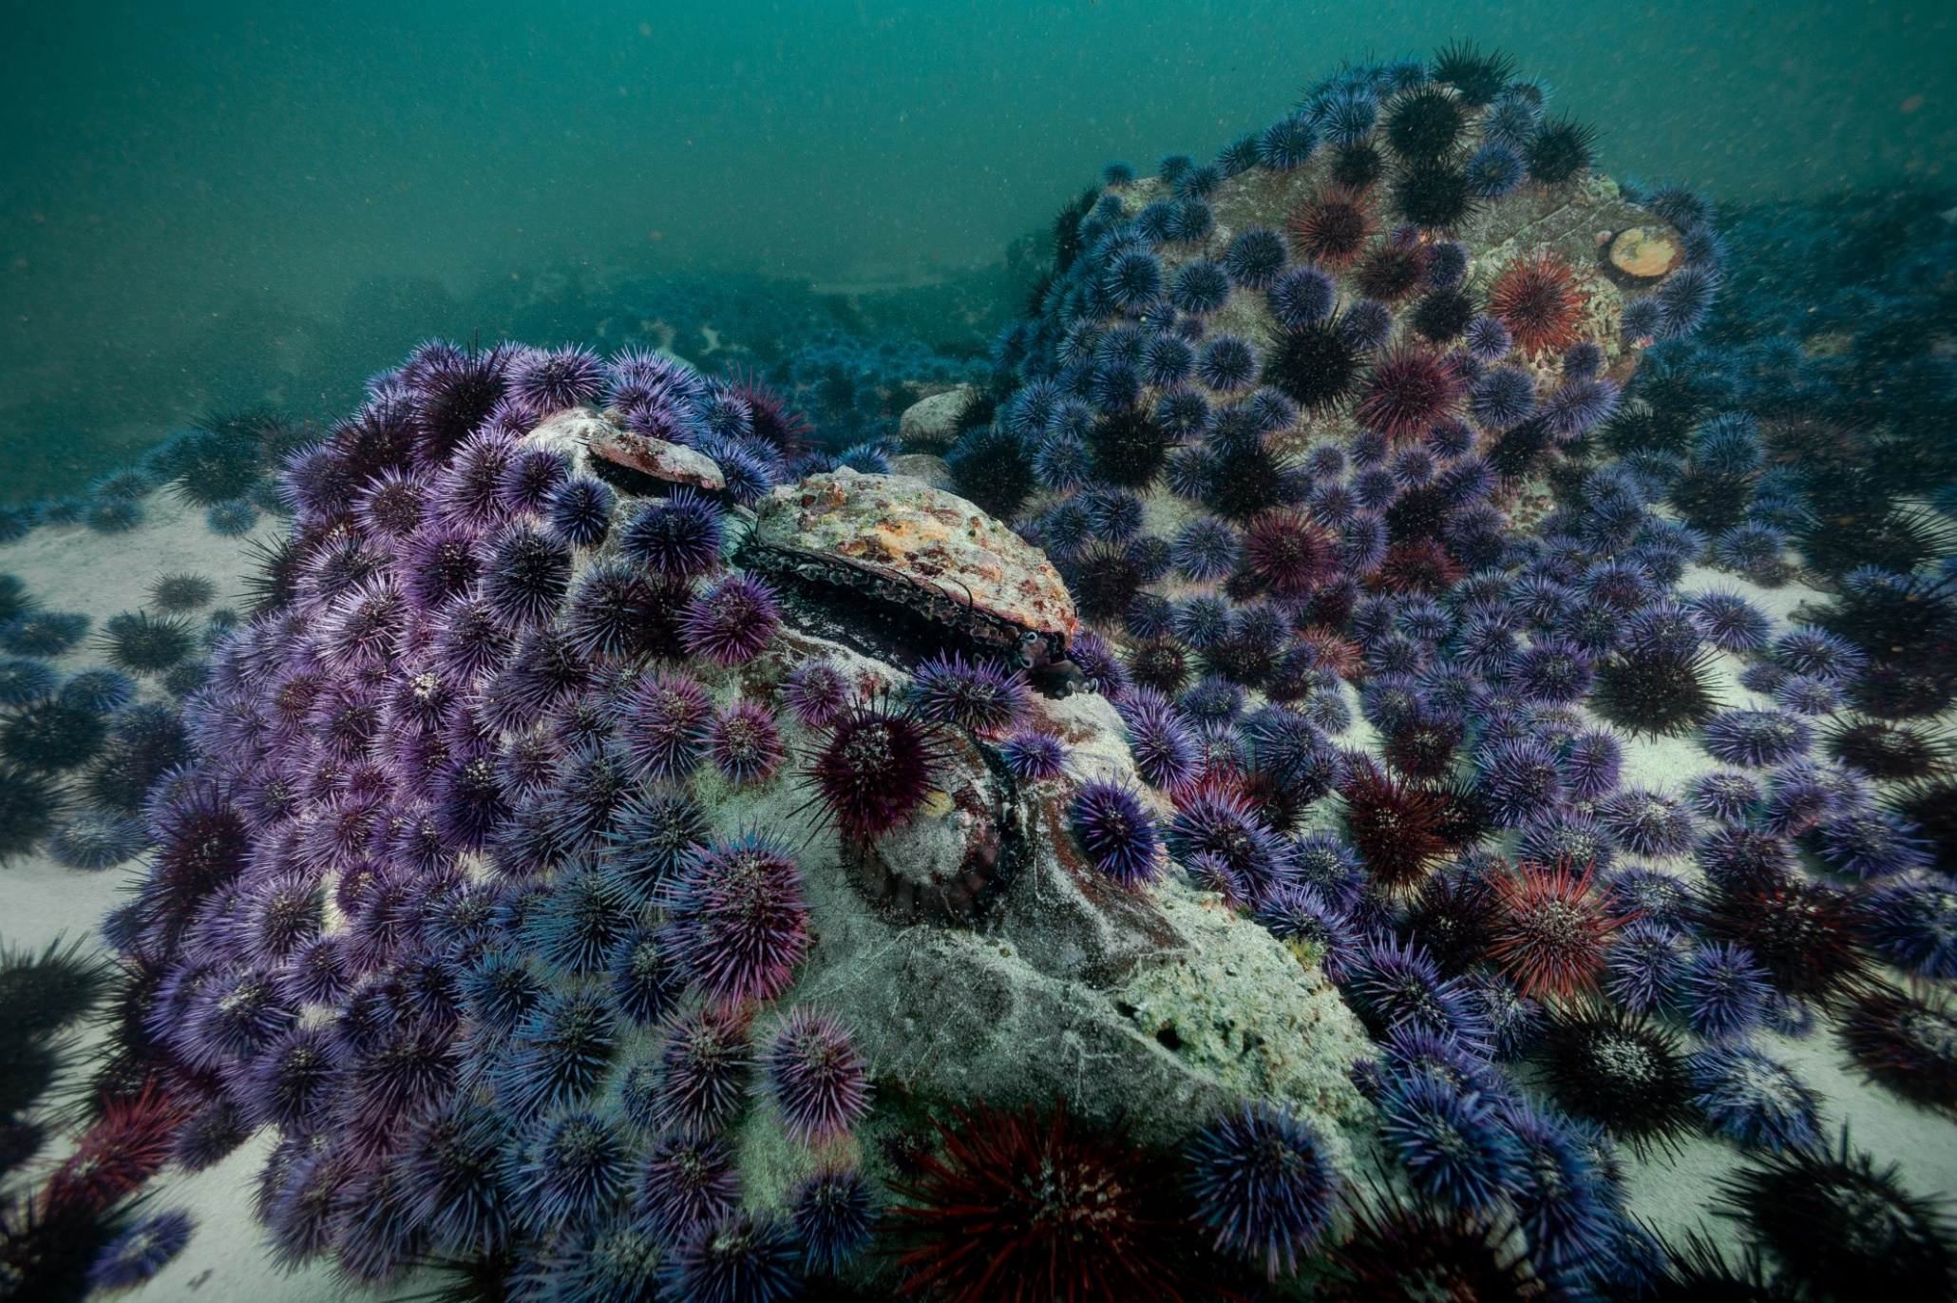

Slide 33

Notes:
So what can we do? Well, luckily our long term monitoring program has tracked such changes through time, providing us with the insight necessary to make better management decisions

Slide 34
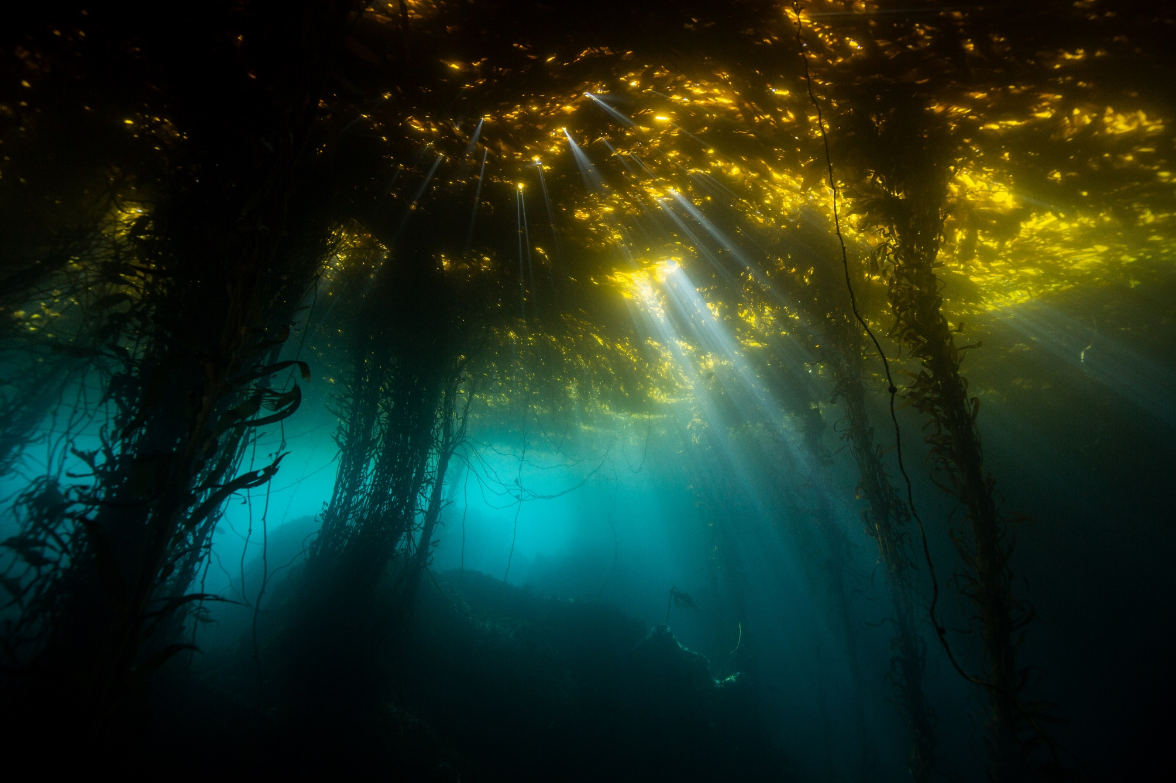
Michael Langhans
Notes:
And the establishment of protected areas encompassing these ecologically and economically important ecosystems grants the Channel Islands’ kelp forests more resiliency in light of changing conditions

Slide 35
Questions?

